Slide 1
Data-Driven Behavioral Analytics: Observations, Representations and Models
Meng Jiang (UIUC)
Peng Cui (Tsinghua)
Jiawei Han (UIUC)
http://www.meng-jiang.com/tutorial-cikm16.html
Tutorial in CIKM 2016, October 24, Indianapolis, IN
Notes:
[University]

Slide 2
I. Mining behavior networks with social and spatiotemporal contexts
I.2. Suspicious behavior detection

Slide 3
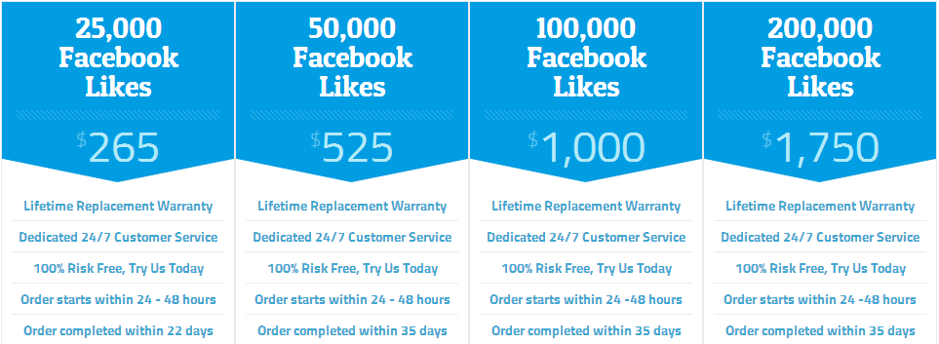
Ill-gotten Facebook Likes

Slide 4
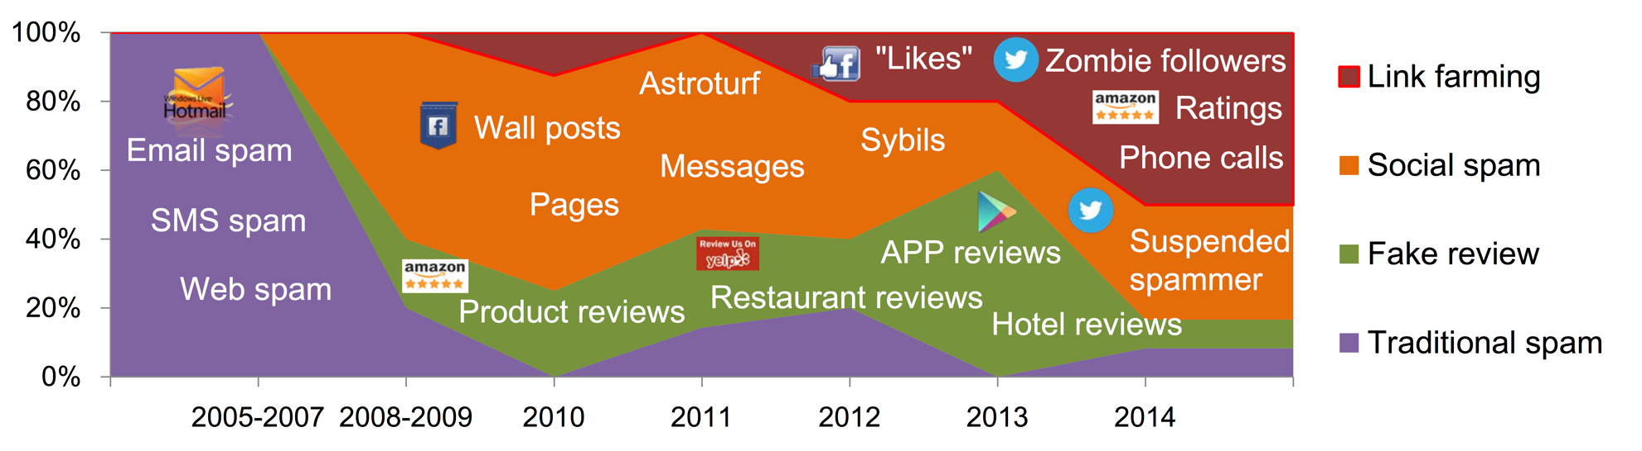
Suspicious Behavior Detection
Social Link Farming
Meng Jiang, Peng Cui and Christos Faloutsos.
Suspicious Behavior Detection: Current Trends and Future Directions.
IEEE Intelligent Systems (ISSI), 2016.

Slide 5
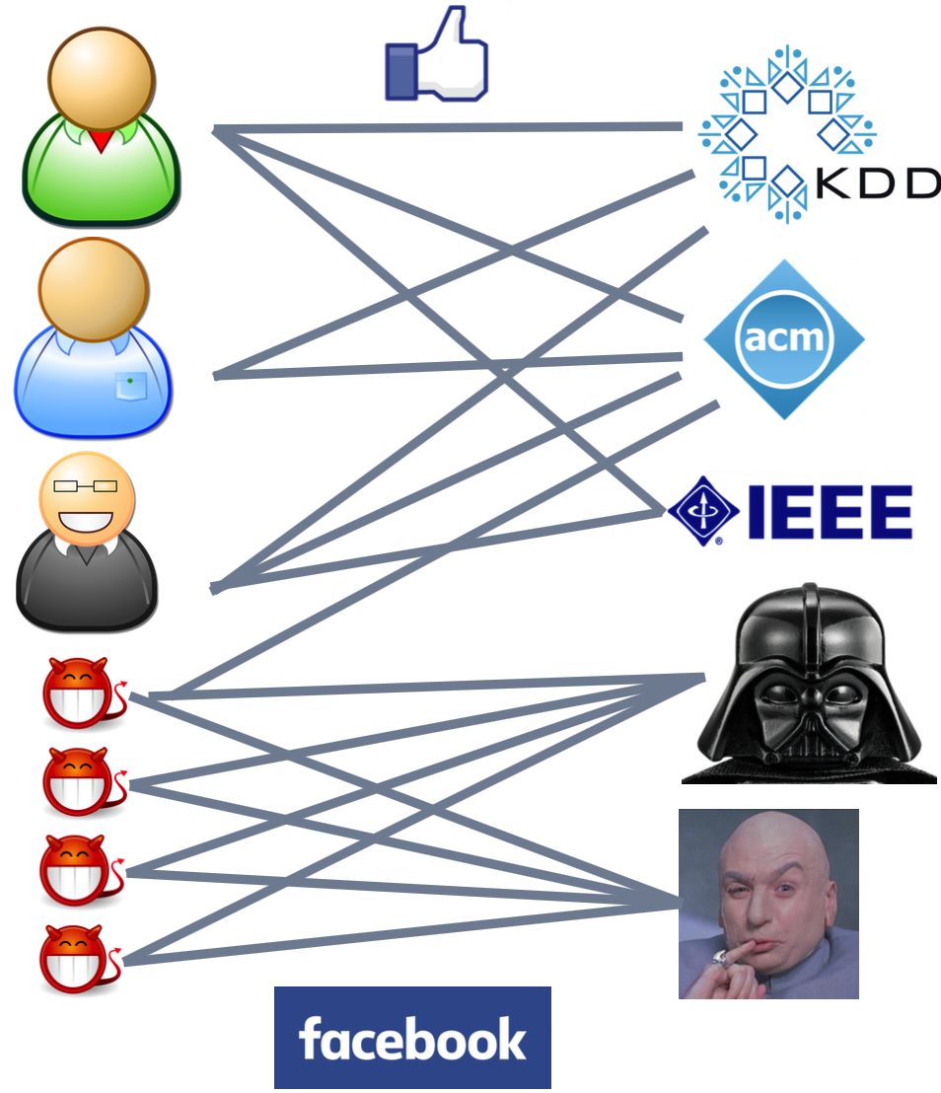
Ill-gotten Facebook Likes
Beutel et al. CopyCatch: Stopping Group Attacks by Spotting Lockstep Behavior in Social Neworks. WWW, 2013.

Slide 6
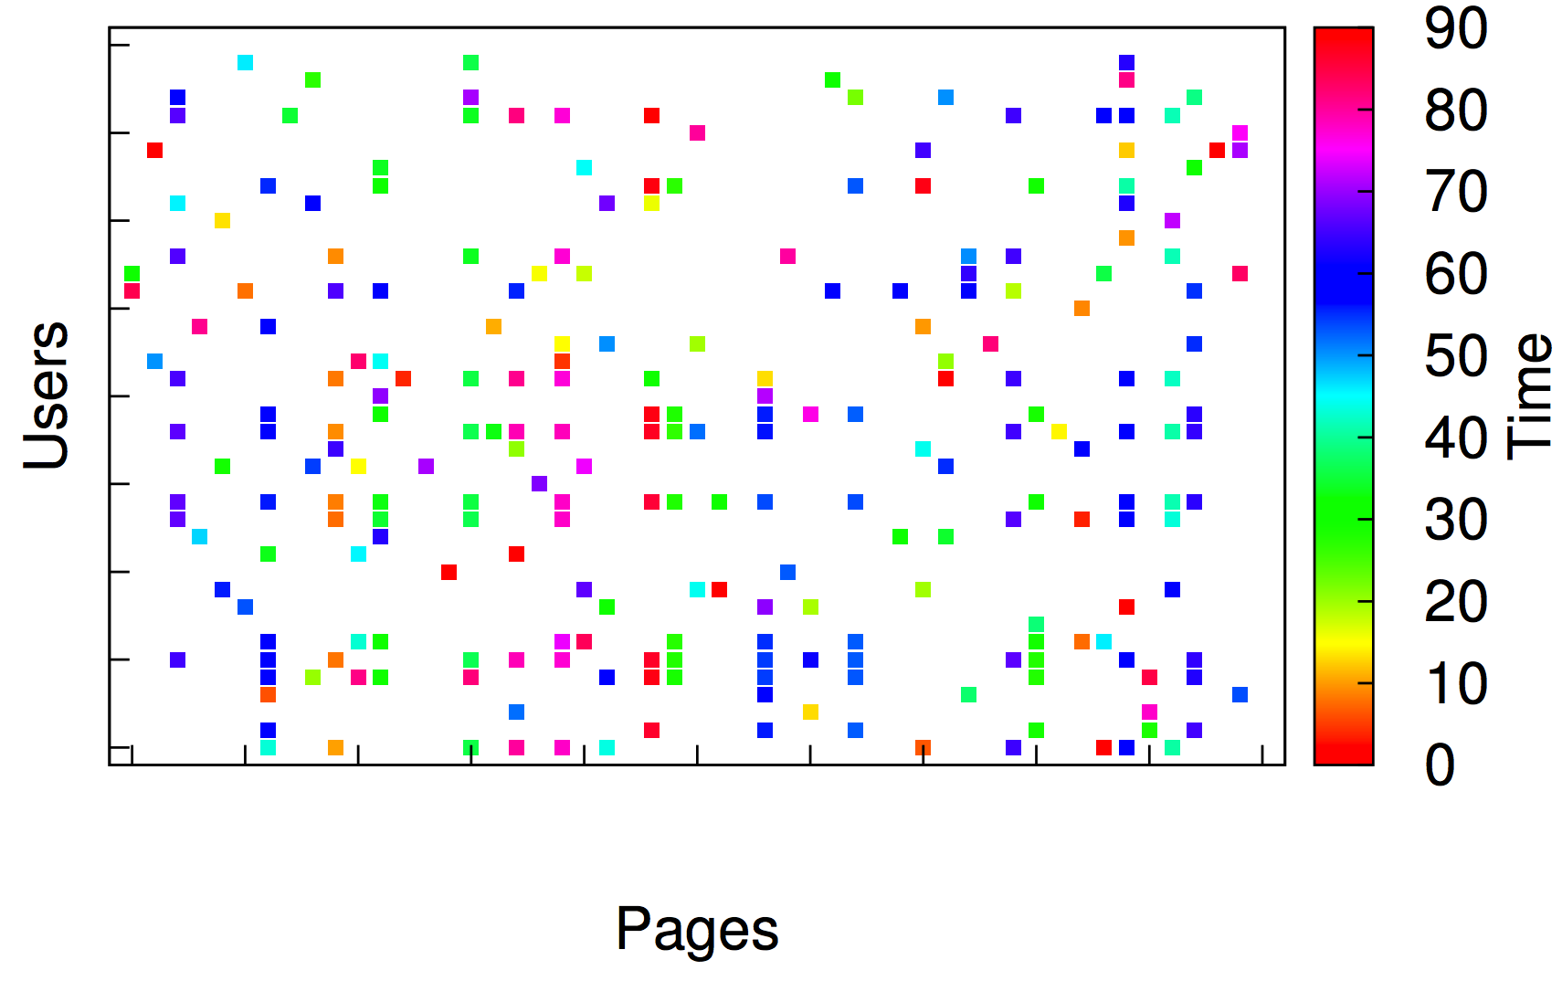
Observation: Graphical View

Slide 7
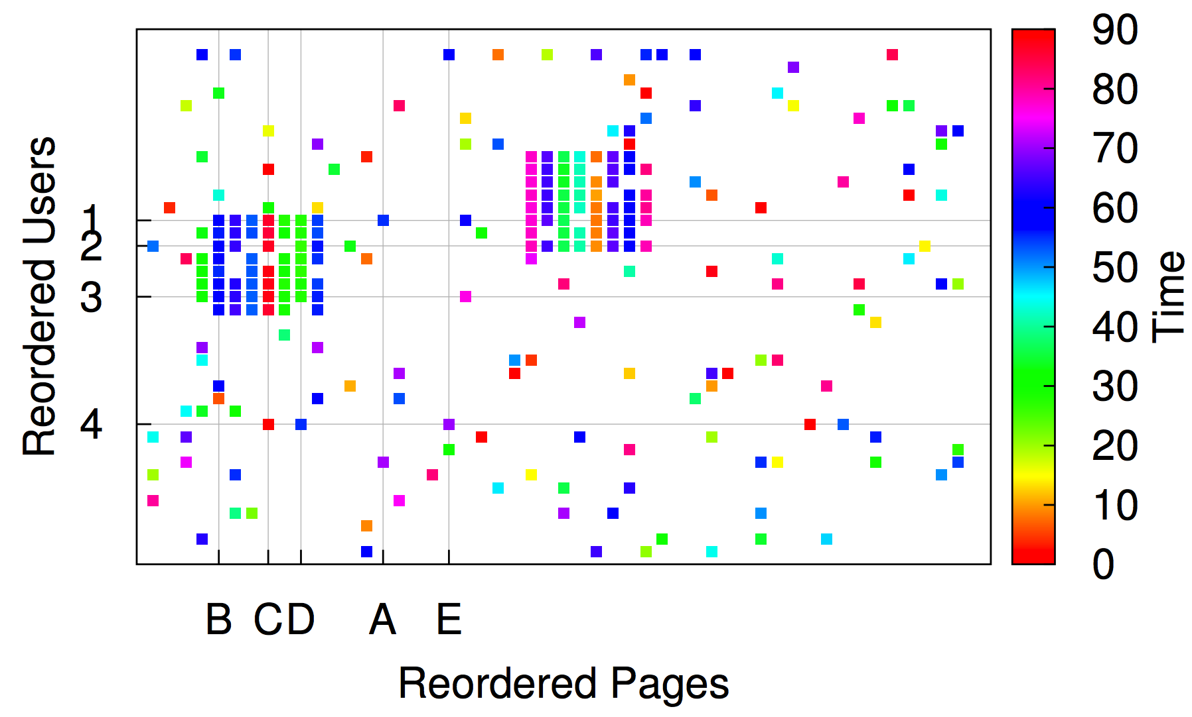
Observation: Reorder Matrix

Slide 8
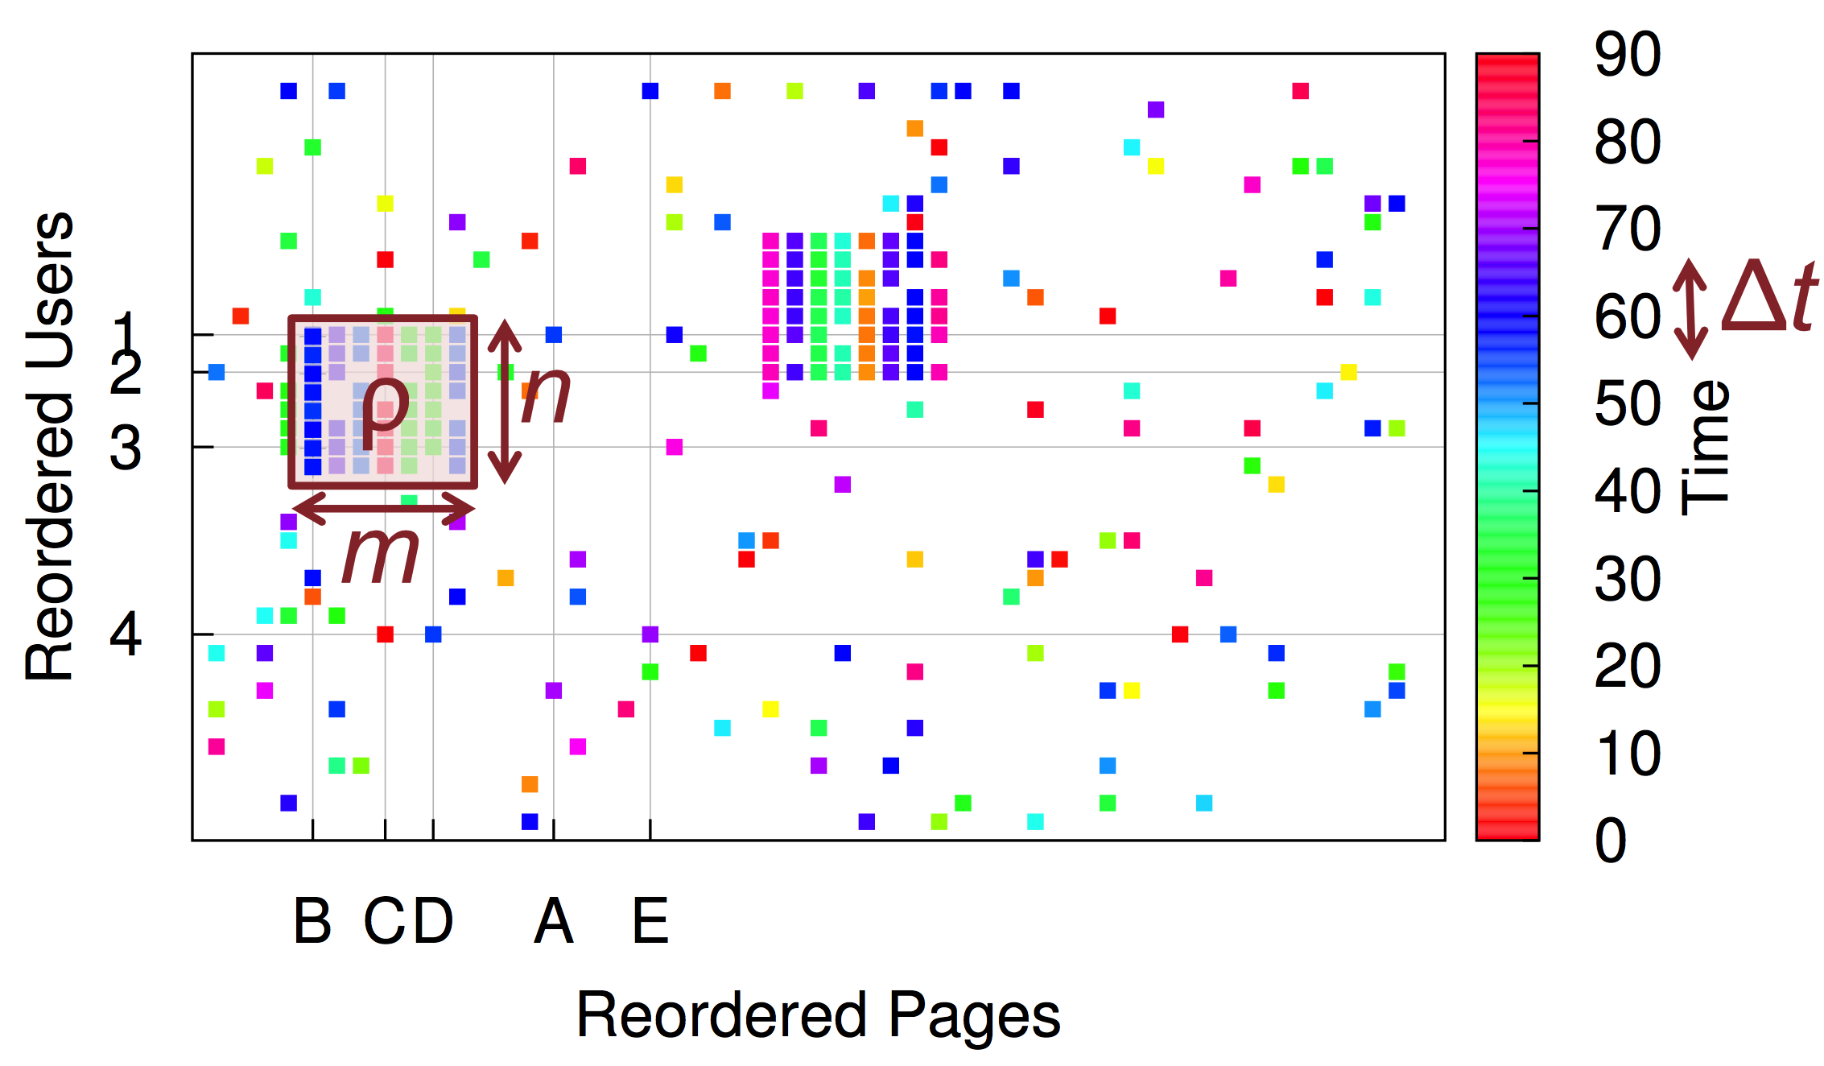
Algorithm: Seed + Search
CopyCatch
“Near Bipartite Core”: n users, m Pages, ρ, Δt

Slide 9
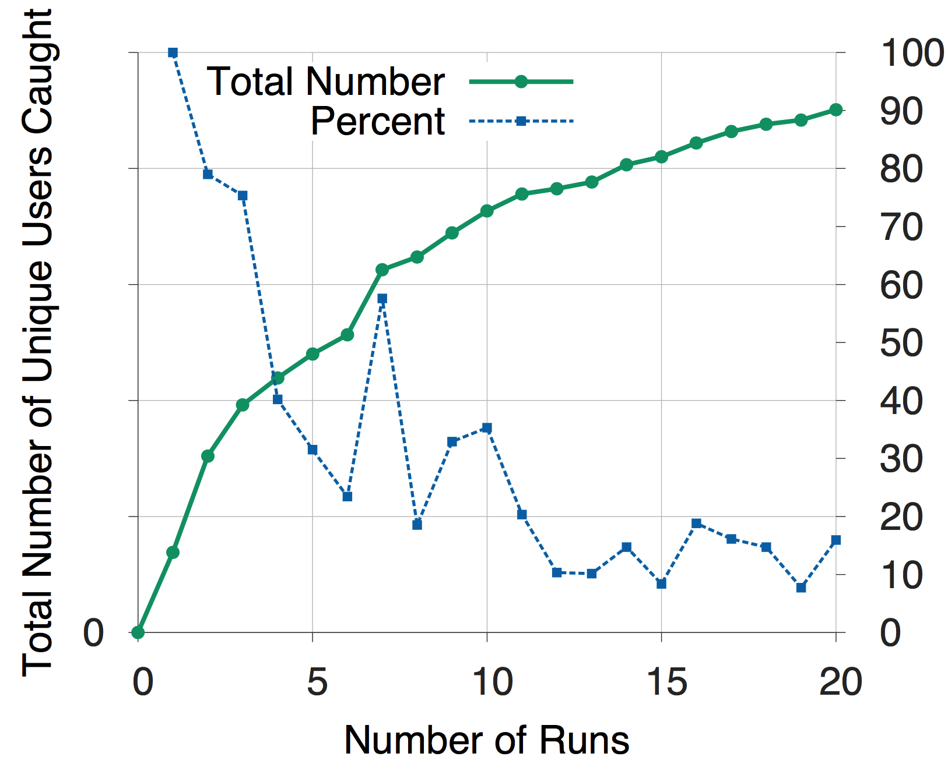
Experimental Result
Seed Selection!!!

Slide 10

Serious Problem in Weibo
Experience-driven approaches:
features of #followees, #hashtags, #URLs…
×

Slide 11


Zombie Followers
Follow
× 1,000
× 100
× 5,000
× 100
× ….
× ….
Jiang et al. Inferring Strange Behavior from Connectivity Pattern in Social Networks. PAKDD, 2014.

Slide 12
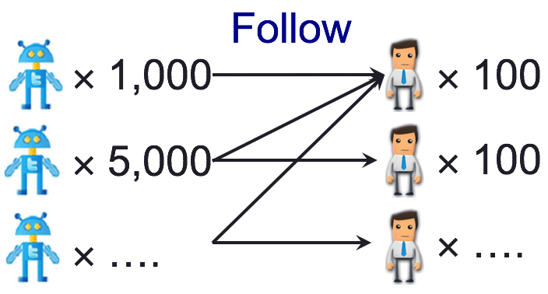

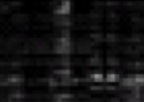

Observation: Reorder Matrix
Seeds
Given
Reorder

Slide 13
Representation: SVD Reminder
followee
followee
U₁U₂
×
…
V₁V₂
×
follower
follower
×
1
follow
2
×
Graph Structure
Adjacency Matrix
SVD: A=USV^{T}

Slide 14
Representation: Spectral Subspace
followee
U₁U₂
…
V₁V₂
follower
Pairs of singular vectors:
SVD: A=USV^{T}
U₂
V₂
U₁
V₁
“Spectral Subspace Plot”

Slide 15
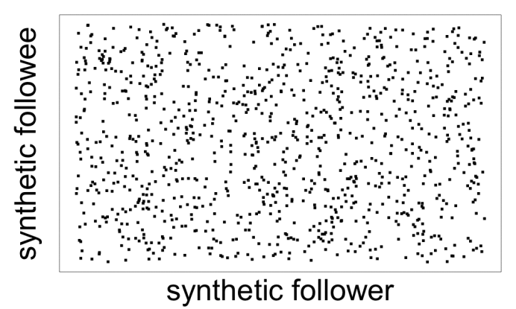
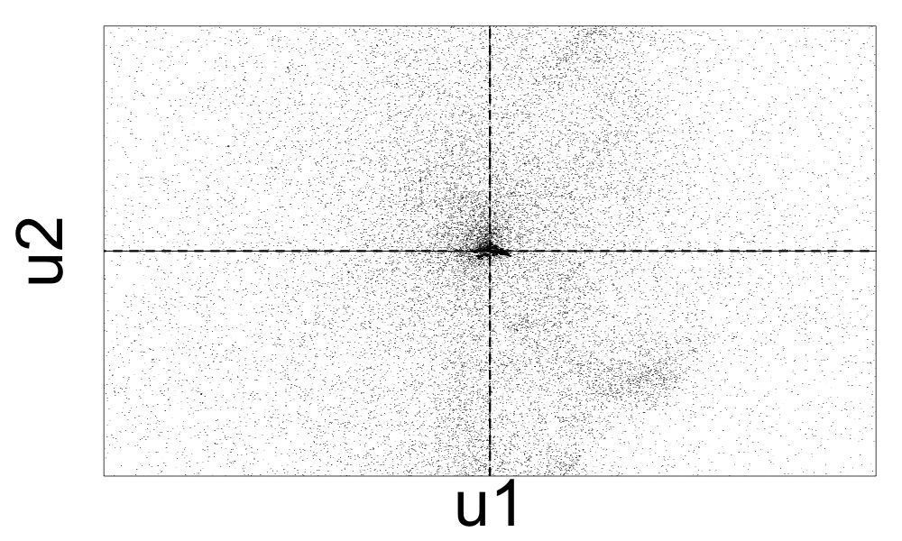
Spectral Subspace Plot: Case #0
NO lockstep behavior: Scatter
Adjacency Matrix
Spectral Subspace Plot

Slide 16
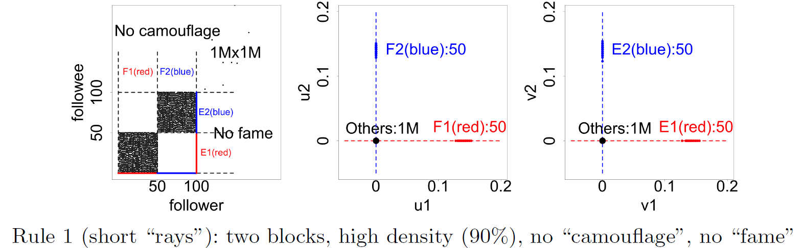
Spectral Subspace Plot: Case #1
Non-overlapping lockstep: “Rays”
Adjacency Matrix
Spectral Subspace Plot

Slide 17
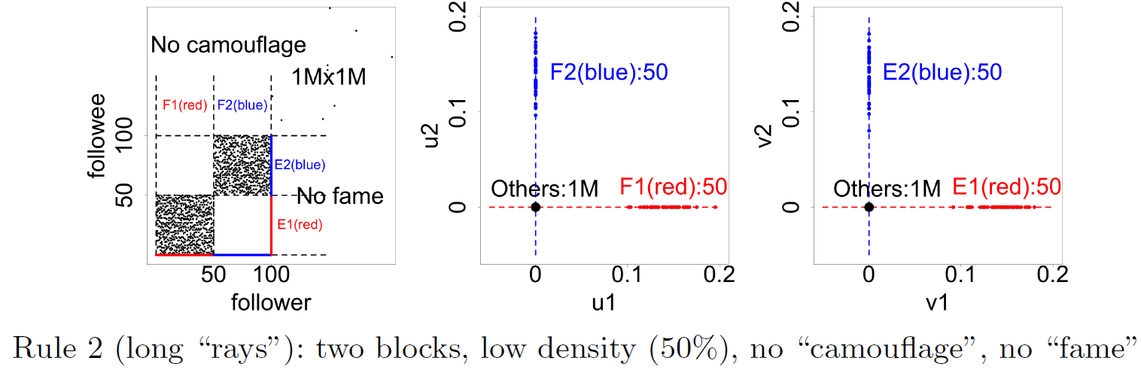
Spectral Subspace Plot: Case #2
Non-overlapping: Low density, Elongation
Adjacency Matrix
Spectral Subspace Plot

Slide 18
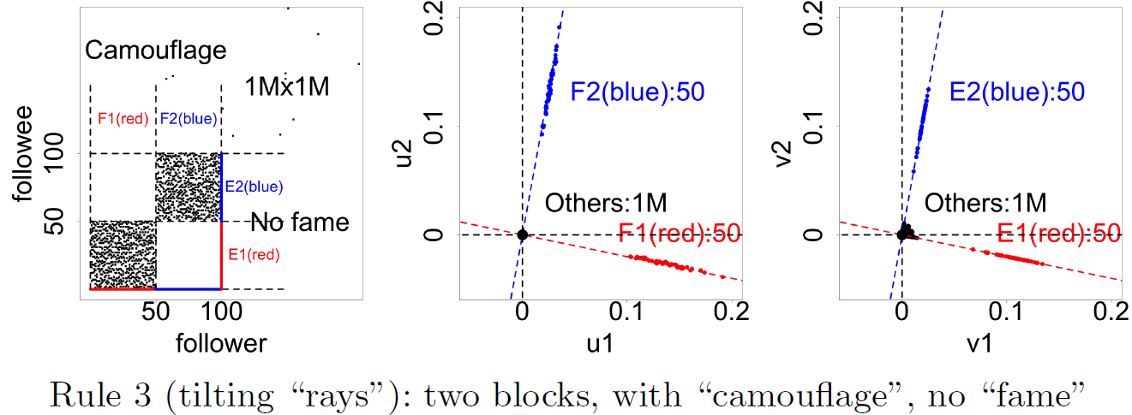
Spectral Subspace Plot: Case #3
Non-overlapping: Camouflage/Fame, Tilting
Adjacency Matrix
Spectral Subspace Plot

Slide 19
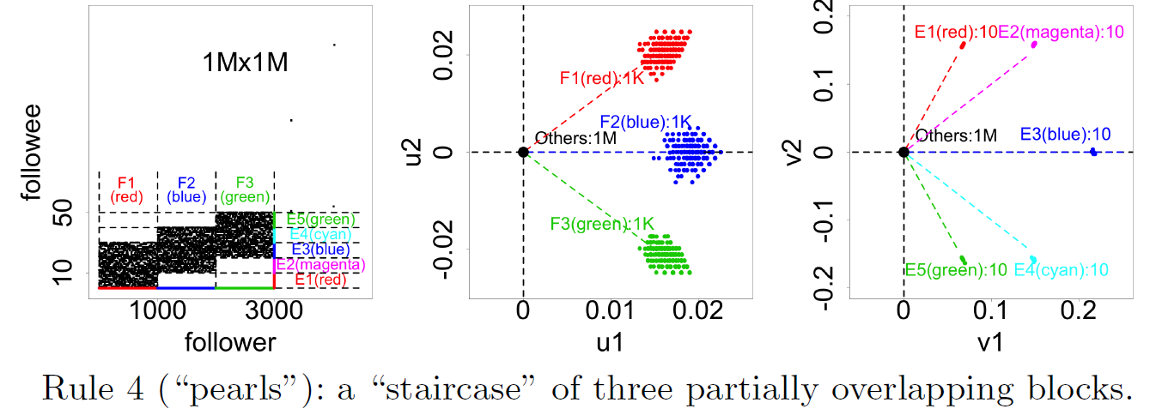
Spectral Subspace Plot: Case #4
Overlapping: “Staircase”, “Pearls”
Adjacency Matrix
Spectral Subspace Plot

Slide 20
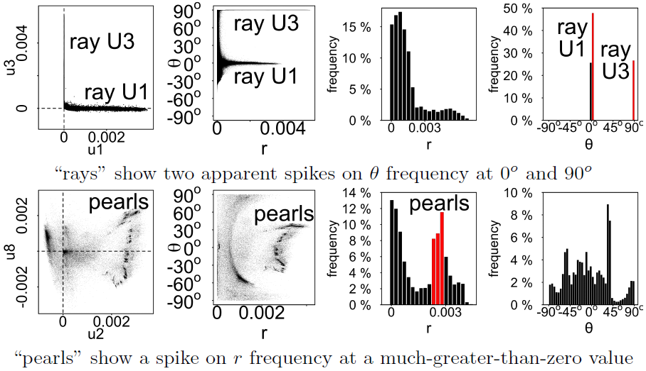
Algorithm: Reading & LockInfer
Spectral
Subspace Plot
Polar Coordinate
Transform
Histograms
High precision but low recall!!!

Slide 21
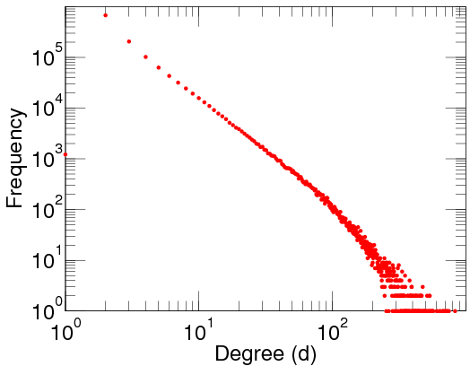
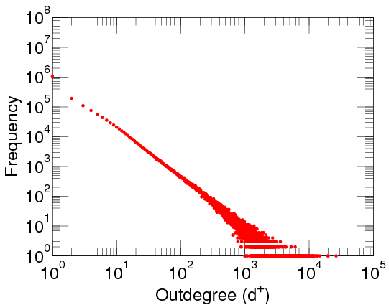
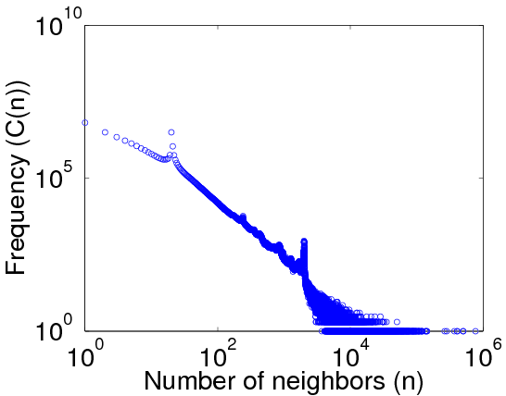
Out-Degree Distributions
Power-law distribution [Faloutsos et al. SIGCOMM; Broder et al. Computer Networks; Chung et al. PNAS]
DBLP Author-publication | Flickr User-user | Twitter Who-follows-whom
[konect.uni-koblenz.de/networks/]

Slide 22


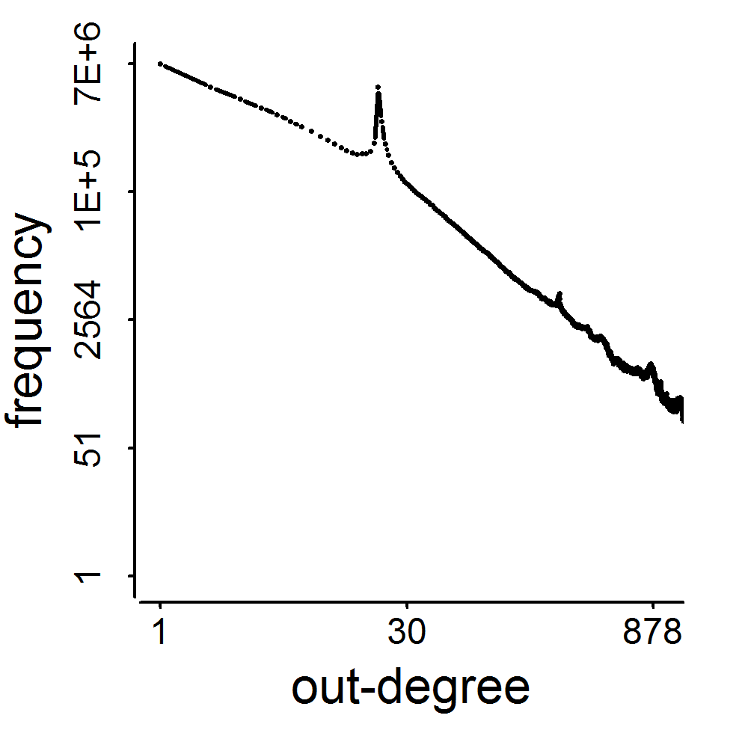
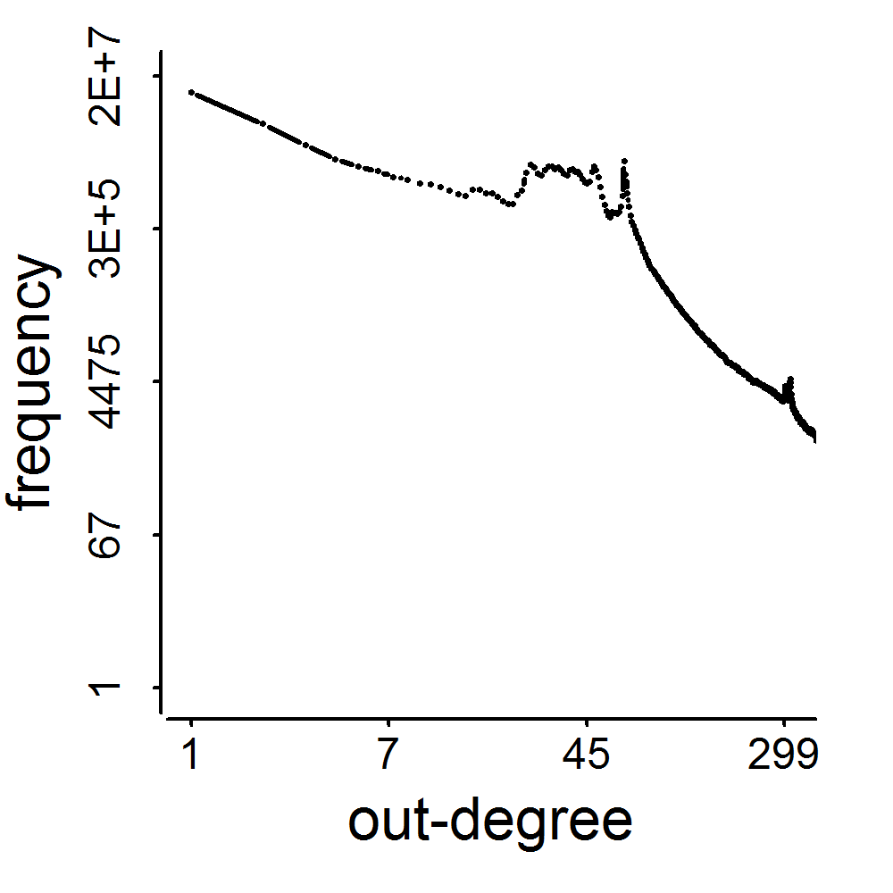
Spikes!
2009
41M
2011
117M
3.17M
1.91M
0.41M
0.44M
d=20
d=64

Slide 23
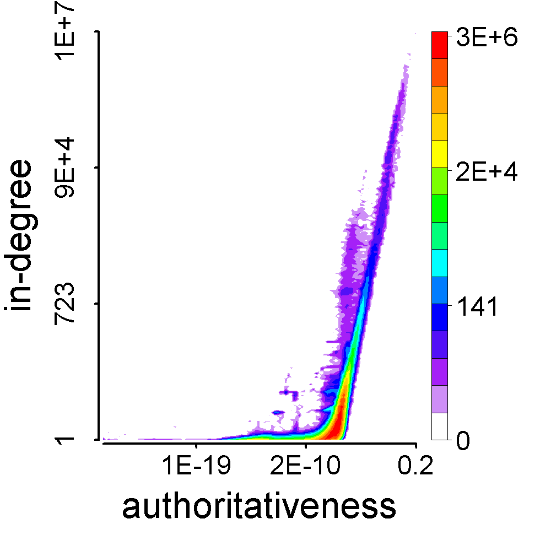
Observation: How They Behave
Feature space of followees [Kleinberg. JACM]
President Barack Obama
Meng Jiang

Slide 24
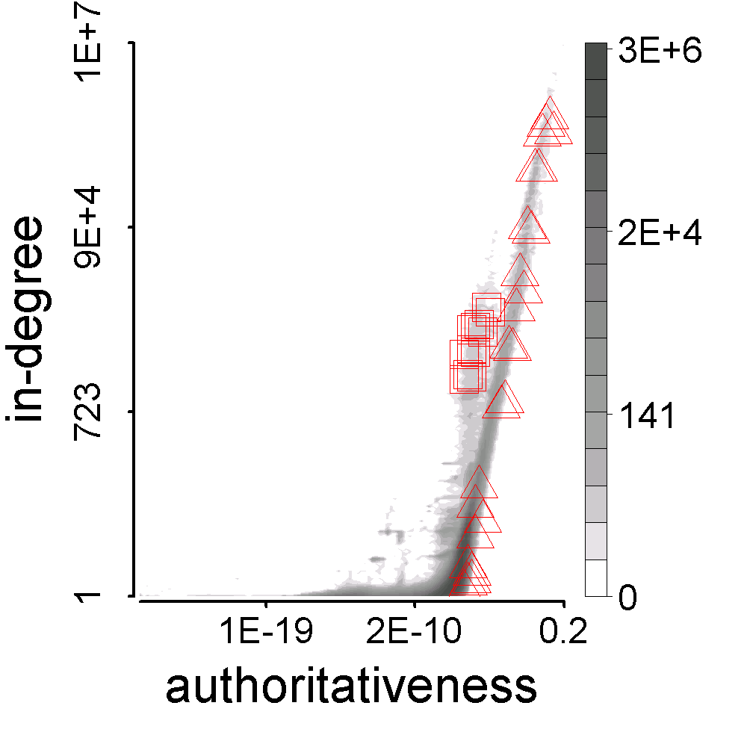
Observation: How They Behave
Who are their followees?
Their behavioral pattern
Synchronized
Similar with each other
Abnormal
Different from the majority
Meng Jiang
#followee=117
BuyAB22
#followee=20

Slide 25
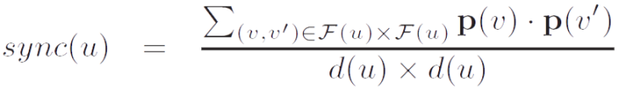
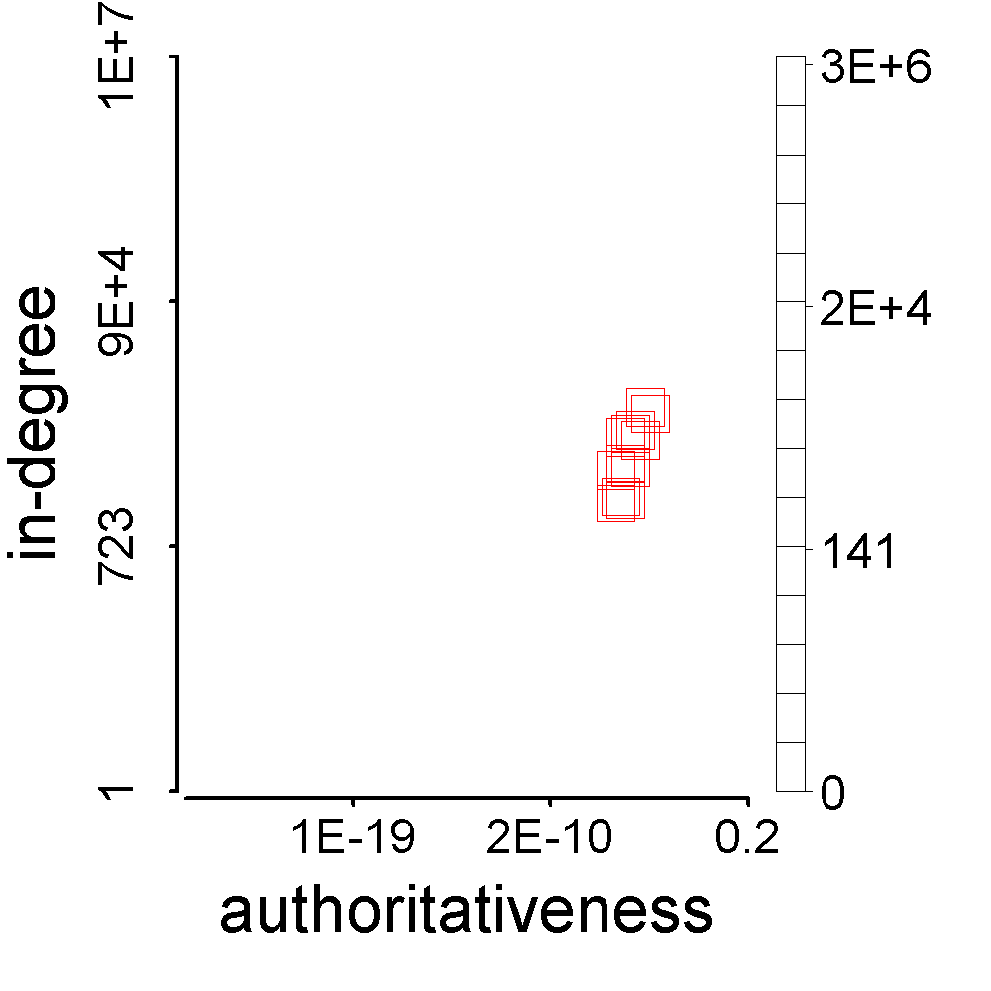
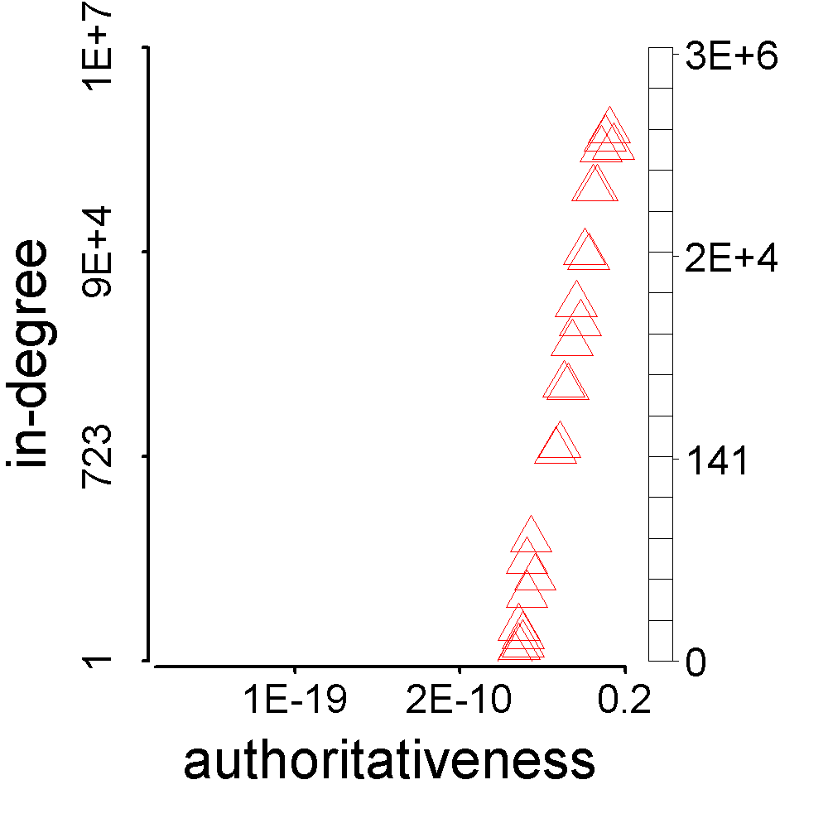
Represent Synchronicity
>

Slide 26
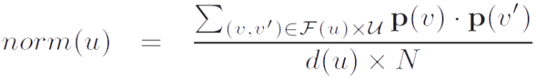
Represent Normality
<

Slide 27

Theorem: Synchronicity vs. Normality
G grids
fp_{g}: #foreground points in grid g
∑fp_{g} = F = d(u) (#followees of u)
Given normality
n = ∑(fp_{g}/F) (bp_{g}/B) = ∑f_{g}b_{g},
find minimal synchronicity
s = ∑(fp_{g}/F) (fp_{g}/F) = ∑f_{g}²
where
∑f_{g} = 1, ∑b_{g} = 1
bp_{g}: #background points in grid g
∑bp_{g} = B = N (#all users)

Slide 28
Theorem: Synchronicity vs. Normality
G grids
Solution.
Lagrange multiplier:
minimize s(f_{g}) = ∑f_{g}²
subject to ∑f_{g} = 1, ∑f_{g}b_{g} = n
Lagrange function:
F(f_{g}, λ, μ) = (∑f_{g}²) + λ(∑f_{g} – 1) + μ(∑f_{g}b_{g} – n)
Gradients:
▽f_{g}F = 2 f_{g} + λ + μ b_{g} = 0
▽λF = ∑f_{g} – 1 = 0
▽μF = ∑f_{g}b_{g} – n = 0
2 + λ G + μ = 0
2 n + λ + μ s_{b} = 0
2 s_{min} + λ + μ n = 0
where s_{b} = ∑b_{g}².
Therefore,
– G n² + 2 n – s_{b}
1 – G s_{b}
∑
× b_{g} ∑
× f_{g} ∑
s_{min} =

Slide 29
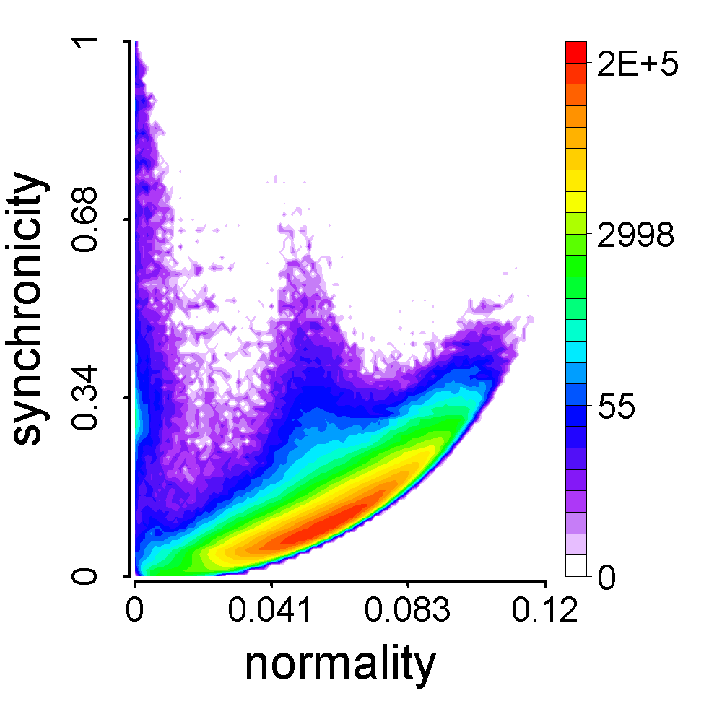
CatchSync Algorithm
G grids
– G n² + 2 n – s_{b}
1 – G s_{b}
s_{min} =
BuyAB22
Meng
Jiang

Slide 30
Experimental Results
CatchSync+SPOT
CatchSync
SPOT
OutRank
CatchSync+SPOT
CatchSync
SPOT
OutRank

Slide 31
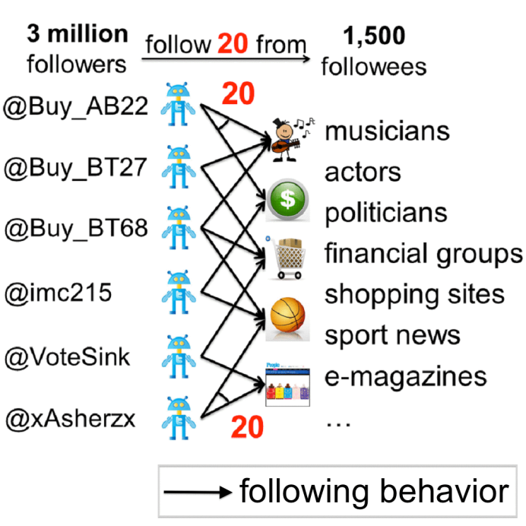
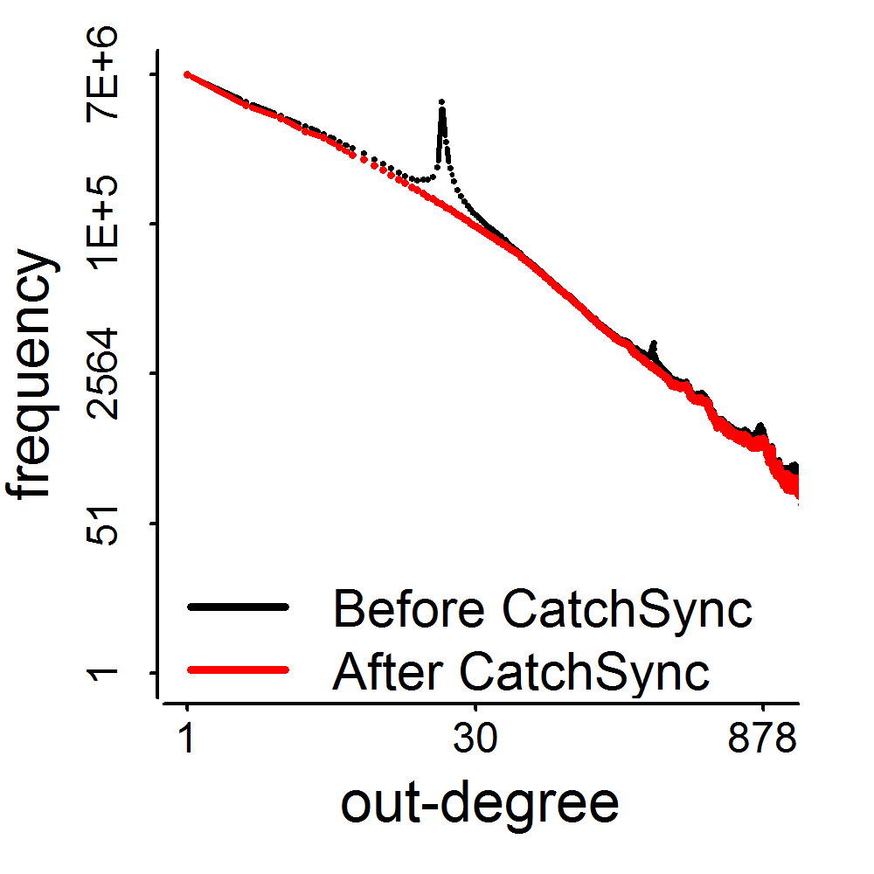
Experimental Results
3.17M
0.41M
d=20

Slide 32
Impact
M. Jiang, P. Cui, A. Beutel, C. Faloutsos and S. Yang. “CatchSync: Catching Synchronized Behavior in Large Directed Graphs” in KDD’14 Best Paper Finalist, Aug 2014. (#citations = 36)
Taught in
CMU 15-826: Multimedia Databases and Data Mining
UMich EECS 598: Graph Mining and Exploration at Scale
ASONAM’16 Tutorial: “Identifying Malicious Actors on Social Media” by S. Kumar, F. Spezzano, V.S. Subrahmanian
Deployed in Weibo? Unfortunately, in July 2014…
Notes:
[36] [26]

Slide 33
Observation: Spatiotemporal Contexts
Dataset | Dimension/Mode |  |  |  | Mass
Weibo’s Retweeting | User | Root ID | IP | Time (min) | #retweet
 | 29.5M | 19.8M | 27.8M | 56.9K | 211.7M
Weibo’s Trending (Hashtag) | User | Hashtag | IP | Time (min) | #tweet
 | 81.2M | 1.6M | 47.7M | 56.9K | 276.9M
Network attacks (LBNL) | Src-IP | Dest-IP | Port | Time (sec) | #packet
 | 2,345 | 2,355 | 6,055 | 3,610 | 230,836
Jiang et al. A General Suspiciousness Metric for Dense Blocks in Multimodal Data. ICDM, 2015.

Slide 34


Dense Block Indicates Suspiciousness
200 minutes
120 minutes
time
time
user
225
user
40
IP
12,375
2
27,313
Q: Which is more suspicious?
We need a metric to evaluate the suspiciousness.

Slide 35
Criteria for Suspiciousness Metric
What properties are required of a good metric?
N₁ ⨉ N₂ ⨉ N₃
Count data with total “mass” C
f(
)
f(
n’₁ ⨉ n’₂ ⨉ n’₃
mass c’
density ρ’
)
n₁ ⨉ n₂ ⨉ n₃
mass c
density ρ
vs

Slide 36
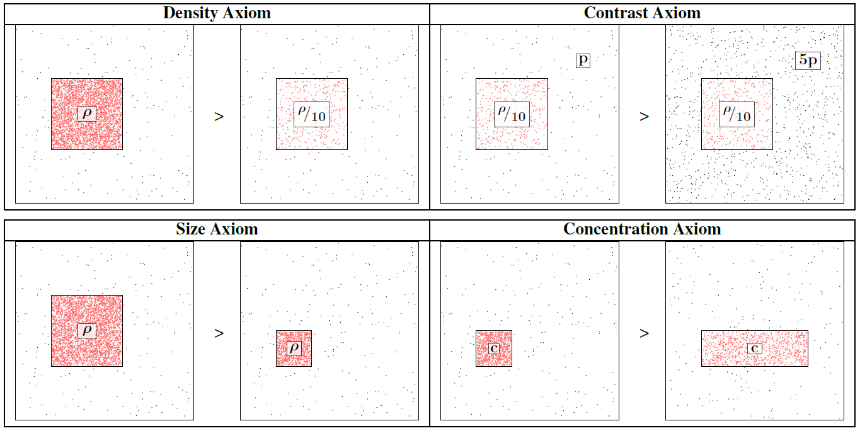
Axioms: 1 to 4

Slide 37
Axiom 5: Cross Dimensions
Not including a mode is the same as
including all values for that mode.
=
▶ New information (more modes) can only
make our blocks more suspicious

Slide 38
Scoring the Suspiciousness
200 minutes
120 minutes
time
time
user
225
user
40
IP
12,375
2
27,313
Q: Which is more suspicious?

Slide 39
Scoring the Suspiciousness
200 minutes
120 minutes
time
time
user
225
user
40
IP
12,375
2
27,313
Probability
0.9%
0.05%

Slide 40
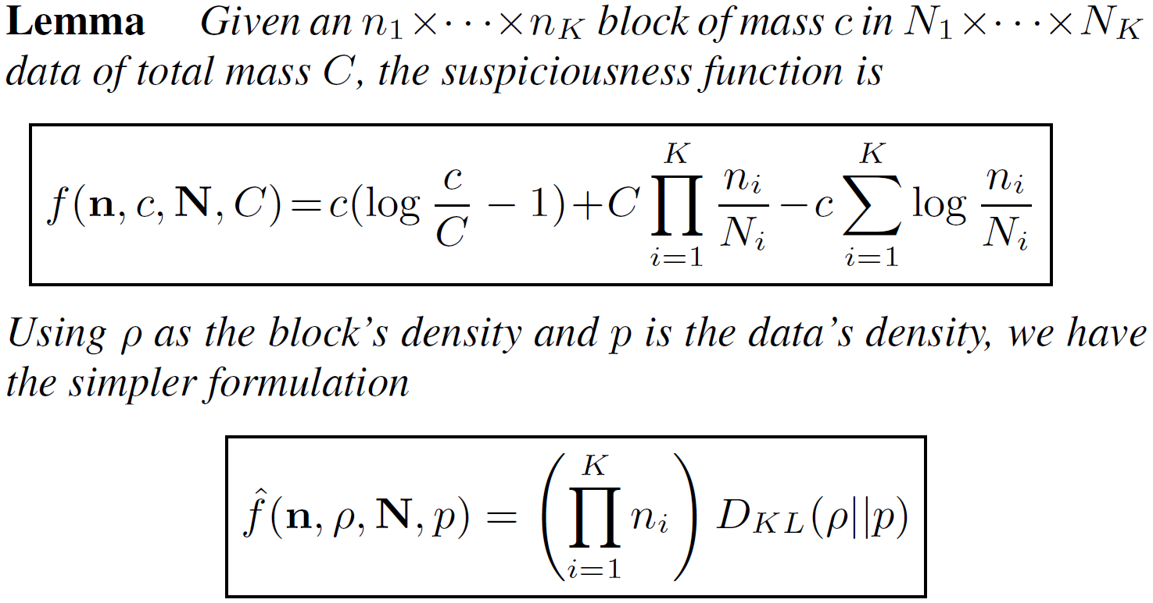
A General Suspiciousness Metric
Negative log likelihood of block’s probability

Slide 41
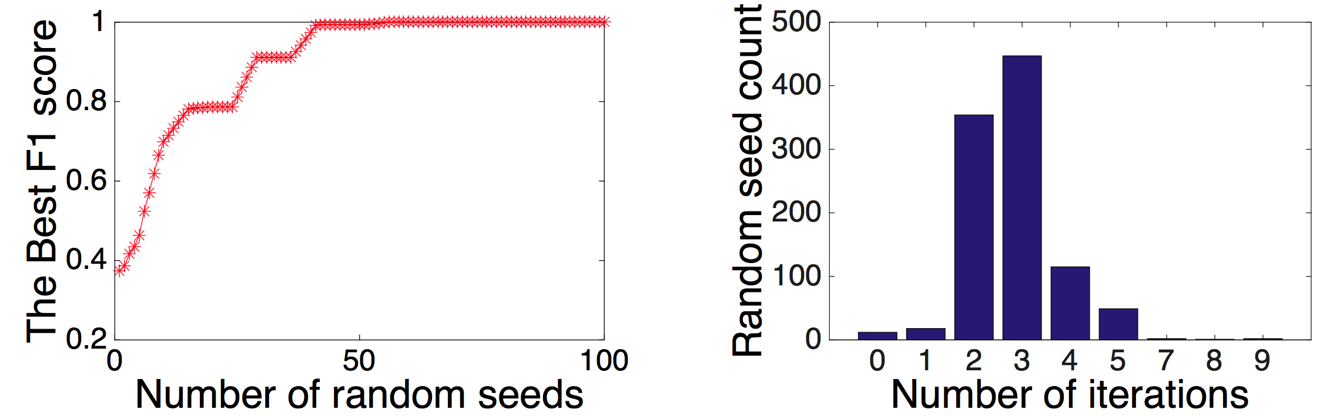
CrossSpot Algorithm
Local search to maximize the metric
Start with seed blocks
Parameter-free: iteratively update the blocks
Scalable: parallelize to multiple machines

Slide 42
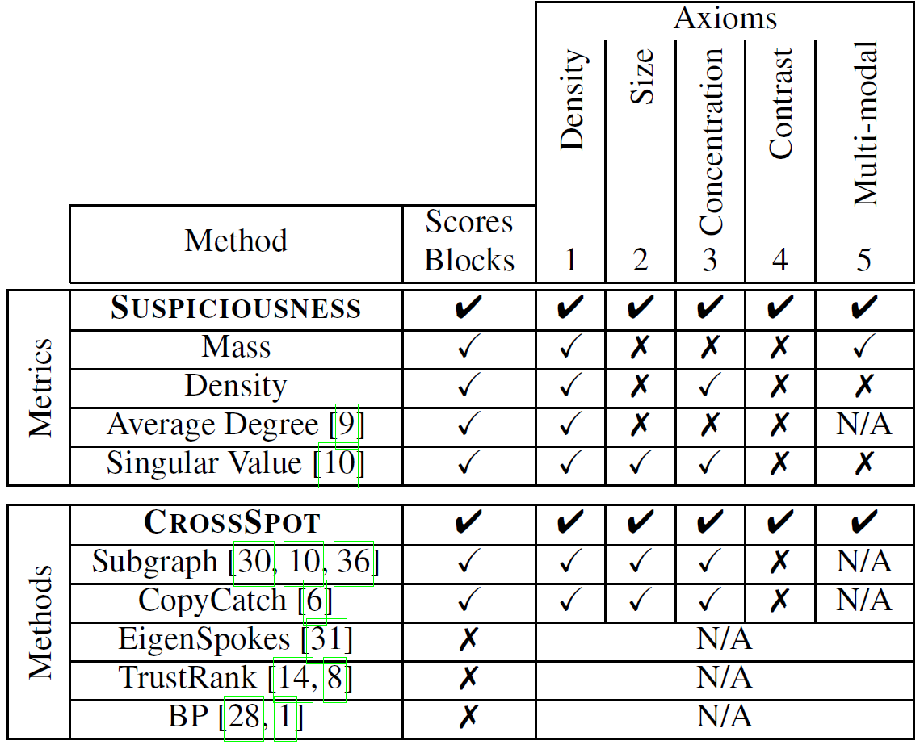
Advantages

Slide 43
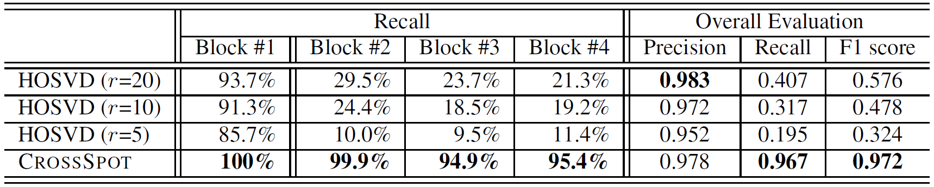
Results: Dense Block Detection
Synthetic data
1,000×1,000×1,000 of 10,000 random data
Block#1: 30×30×30 of 512 3 modes
Block#2: 30×30×1,000 of 512 2 modes
Block#3: 30×1,000×30 of 512 2 modes
Block#4: 1,000×30×30 of 512 2 modes

Slide 44
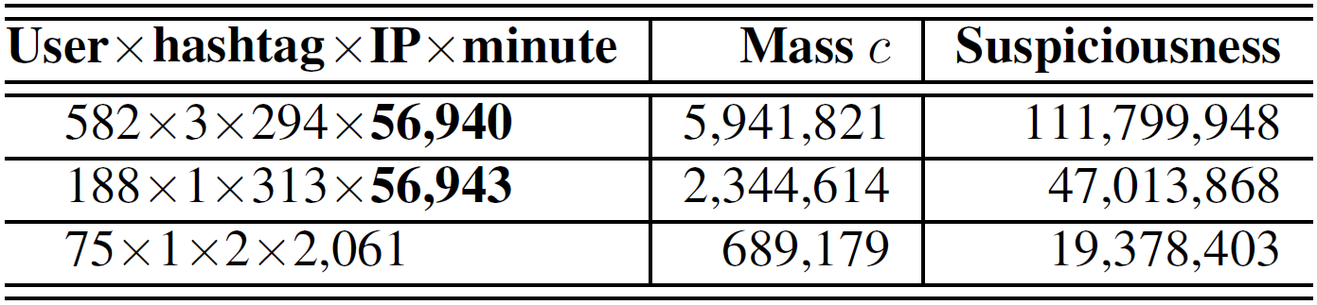
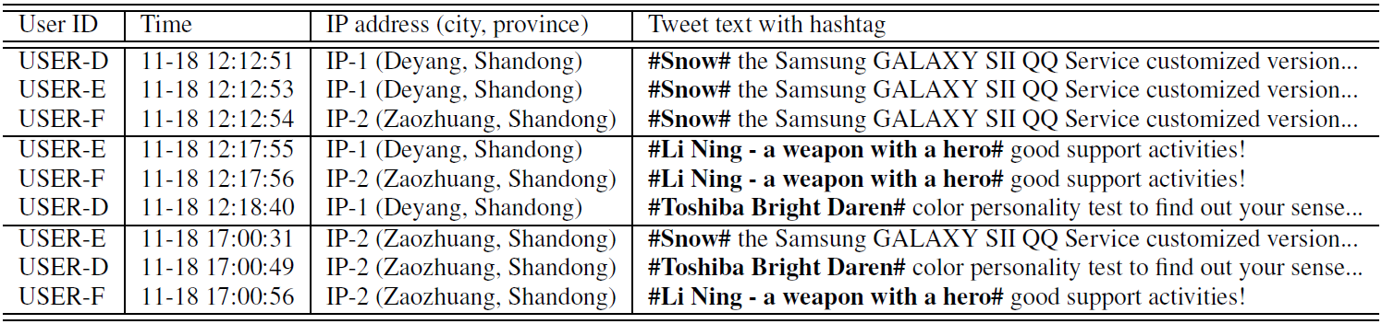
Results: Tweeting Hashtags

Slide 45
Results: Network Attacks

Slide 46
Summary
Ill-gotten Facebook Likes, Zombie Followers
Observations, Representations, Models
CopyCatch: Catching ill-gotten Likes by core search
LockInfer: Adding seed selection before search
CatchSync: Catching smart zombie followers with high recall (recovering power-law distributions)
CrossSpot: Defining suspiciousness across dimensions

Slide 47

Acknowledgement

Slide 48
References
D. Blei, A. Ng, and M. Jordan. “Latent dirichlet allocation.” JMLR, 2003.
J. Herlocker, J. Konstan, L. Terveen, J. Riedl. “Evaluating collaborative filtering recommender systems.” ACM TOIS, 2004.
Y. Koren, R. Bell, C. Volinsky. “Matrix factorization techniques for recommender systems.” Computer, 2009.
Y. Koren. “Factorization meets the neighborhood: A multifaceted collaborative filtering model.” KDD, 2008.
Y. Koren. “Collaborative filtering with temporal dynamics.” CACM, 2010.
M. Balabanovic and Y. Shoham. “FAB: Content-based, collaborative recommendation.” CACM, 1997.
N. Liu and Q. Yang. “Eigenrank: A ranking-oriented approach to collaborative filtering.” SIGIR, 2008.
N. Liu, M. Zhao, and Q. Yang. “Probabilistic latent preference analysis for collaborative filtering.” CIKM, 2009.

Slide 49
References
H. Ma, H. Yang, M. Lyu, and I. King. “Sorec: Social recommendation using probabilistic matrix factorization.” CIKM, 2008.
H. Ma, T. Zhou, M. Lyu, and I. King. “Improving recommender systems by incorporating social contextual information.” ACM TOIS, 2011.
H. Ma, D. Zhou, C. Liu, M. Lyu, and I. King. “Recommender systems with social regularization.” WSDM, 2011.
J. Leskovec, A. Singh, and J. Kleinberg. “Patterns of influence in a recommendation network.” PAKDD, 2006.
P. Massa and A. Paolo. “Trust-aware recommender systems.” RecSys, 2007.
M. Jamali and E. Martin. “TrustWalker: A random walk model for combining trust-based and item-based recommendation.” KDD, 2009.
H. Ma, I. King, and M. Lyu. “Learning to recommend with social trust ensemble.” SIGIR, 2009.
H. Ma. I. King, and M. Lyu. “Learning to recommend with explicit and implicit social relations.” ACM TIST, 2011.

Slide 50
References
M. Faloutsos, P. Faloutsos, and C. Faloutsos. “On power-law relationships of the internet topology.” SIGCOMM, 1999.
A. Broder, R. Kumar, F. Maghoul, P. Raghavan, S. Rajagopalan, R. Stata, A. Tomkins, and J. Weiner. “Graph structure in the web.” Computer Networks, 2000.
F. Chung and L. Lu. “The average distances in random graphs with given expected degrees.” PNAS, 2002.
J. Kleinberg. “Authoritative sources in a hyperlinked environment.” JACM, 1999.
H. Kwak, C. Lee, H. Park, and S. Moon. “What is Twitter, a social network or a news media?” WWW, 2010.
B. Hooi, H.A. Song, A. Beutel, N. Shah, K. Shin, and C. Faloutsos. “Fraudar: Bounding graph fraud in the face of camouflage.” KDD, 2016.
C. Aggarwal and J. Han. “Frequent pattern mining.” Springer, 2014.
J. Han, J. Pei, B. Mortazavi-Asl, Q. Chen, U. Dayal, and M. Hsu. “FreeSpan: Frequent pattern-projected sequential pattern mining.” KDD, 2000.

Slide 51
References
X. Yan and J. Han. “gspan: Graph-based substructure pattern mining.” ICDM, 2003.
X. Yan and J. Han. “CloseGraph: Mining closed frequent graph patterns.” KDD, 2003.
Y. Sun, J. Han, X. Yan, P.S. Yu, and T. Wu. “PathSim: Meta path-based top-k similarity search in heterogeneous information networks.” VLDB, 2011.
Y. Sun, Y. Yu, and J. Han. “Ranking-based clustering of heterogeneous information networks with star network schema.” KDD, 2009.
Y. Sun, J. Han, P. Zhao, Z. Yin, H. Cheng, and T. Wu. “RankClus: Integrating clustering with ranking for heterogeneous information network analysis.” EDBT, 2009.
Y. Sun, R. Barber, M. Gupta, C. Aggarwar, and J. Han. “Co-author relationship prediction in heterogeneous bibliographic networks.” ASONAM, 2011.
A. El-Kishky, Y. Song, C. Wang, C.R. Voss, and J. Han. “Scalable topical phrase mining from text corpora.” VLDB, 2014.
J. Liu, J. Shang, C. Wang, X. Ren, and J. Han. “Mining quality phrases from massive text corpora.” SIGMOD, 2015.

Slide 52
References
X. Ren, A. El-Kishky, C. Wang, F. Tao, C.R. Voss, and J. Han. “Effective entity recognition and typing by relation phrase-based clustering.” KDD, 2015.
X. Ren, W. He, M. Qu, C.R. Voss, H. Ji, and J. Han. “Label noise reduction in entity typing by heterogeneous partial-label embedding.” KDD, 2016.
C. Wang, M. Danilevsky, N. Desai, Y. Zhang, P. Nguyen, T. Taula, and J. Han. “A phrase mining framework for recursive construction of a topical hierarchy.” KDD, 2013.
E.E. Papalexakis, C. Faloutsos, N.D. Sidiropoulos. “ParCube: Sparse parallelizable tensor decompositions.” PKDD, 2012.
D. Koutra, U. Kang, J. Vreeken, and C. Faloutsos. “VOG: Summarizing and understanding large graphs.” SDM, 2014.
R. Gupta, A. Halevy, X. Wang, S.E. Whang, and F. Wu. “Biperpedia: An ontology for search applications.” VLDB, 2014.
M. Yahya, S. Whang, R. Gupta, and A. Halevy. “ReNoun: Fact extraction for nominal attributes.” EMNLP, 2014.
A. Halevy, N. Noy, S. Sarawagi, S.E. Whang, and X. Yu. “Discovering structure in the universe of attribute names.” WWW, 2016.

Slide 53
References
Q. Li, Y. Li, J. Gao, B. Zhao, W. Fan, and J. Han. “Resolving conflicts in heterogeneous data by truth discovery and source reliability estimation.” SIGMOD, 2014.
Q. Li, Y. Li, J. Gao, L. Su, B. Zhao, M. Demirbas, W. Fan, and J. Han. “A confidence-aware approach for truth discovery on long-tail data.” VLDB, 2014.
F. Ma, Y. Li, Q. Li, M. Qiu, J. Gao, S. Zhi, L. Su, B. Zhao, H. Ji, and J. Han. “Faitcrowd: Fine grained truth discovery for crowdsourced data aggregation.” KDD, 2015.
Y. Li, J. Gao, C. Meng, Q. Li, L. Su, B. Zhao, W. Fan, and J. Han. “A survey on truth discovery.” KDD Explorations Newsletter, 2016.
S. Zhi, B. Zhao, W. Tong, J. Gao, D. Yu, H. Ji, and J. Han. “Modeling truth existence in truth discovery.” KDD, 2015.
S. Kumar, R. West, and J. Leskovec. “Disinformation on the Web: Impact, characteristics, and detection of Wikipedia hoaxes.” WWW, 2016.
S. Kumar, F. Spezzano, and V.S. Subrahmanian. “Identifying malicious actors on social media.” ASONAM, 2016. (tutorial)

Slide 54
Thank you!
Data-Driven Behavioral Analytics:
Observations, Representations and Models

